Slide 1
Earlston Cluster Schools

Slide 2
Starter
Look at the following phrases, write each down under the heading of either Growth Mindset or Fixed Mindset
Intelligence is static
Intelligence can be developed
Embraces Challenges
Avoids Challenges
Gives up easy
Persists in the face of setbacks
Effort is pointless
Effort is the path to mastery
Has a desire to learn
Has a desire to look smart

Slide 3
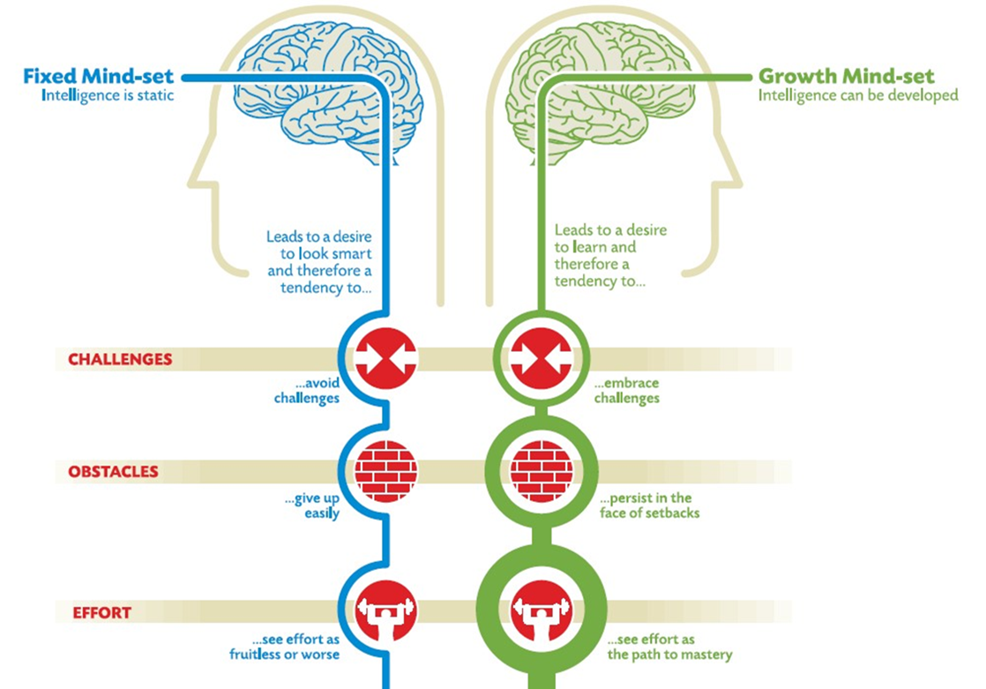
Answers

Slide 4
Brain Smart
Our next block of work will look at things like:
failing your way to success
how you learn
memory techniques
acting on feedback
Setting goals
looking after your brain!
Today’s lesson will focus on reminding ourselves about Growth Mindset

Slide 5
Mindsets recap:
Growth mindset
Belief that people can grow and develop
See failure/setback as a learning opportunity
Put in effort and persist
Try alternative routes to success
Fixed mindset
Belief that ability is fixed
People are born with talent e.g smart/sporty etc
Depressed after failure
Put in less effort
Don’t try new strategies

Slide 6
Growth Mindset
Watch the clip http://www.youtube.com/watch?v=wNG41u3xbDc
What observations can you make to do with growth and fixed mindsets?
Instead of arguing about something, try it out
Taking a risk can lead to success etc
If pigs can have a growth mindset, so can you!

Slide 7
Benefits and Drawbacks
In pairs/small groups, list:
The benefits of having a growth mindset
The drawbacks of having a fixed mindset
Your teacher will collate responses on the board and discuss as a class

Slide 8
Drawbacks of a Fixed Mindset
Do you have things like?
Arrogance
Thinking you’re right all the time
Showing off
Give up when things are too difficult
Get upset when you’re wrong
Negative self-talk when things don’t go right “I’m rubbish at Biology” after failing a test
Limits you from learning new things
Any more?

Slide 9
Benefits of a Growth Mindset
Do you have things like?
Being humble
Learning from mistakes
Open to learning
You believe you can become smarter
Speak positively about yourself
Comfortable making mistakes
Increased resilience
Less likely to be stressed

Slide 10
Quiz
In small groups, listen to the description of the famous ‘growth mindset’ person and write down who you think it is. It could be someone current or from history.
Notes:
You could also choose to do this as a first group to come up with an answer, puts their hand up. If it’s right they get the point. First bullet point is worth 5 points, next worth 4, etc. Keep a tally of scores as you go

Slide 11
Person 1
His club manager said of him “he practised with a discipline to achieve an accuracy that other players wouldn't care about.” and he was a fantastic footballer “…not because of God-given talent but because he practises with a relentless application that the vast majority of less gifted players wouldn’t contemplate”
He suffers from obsessive compulsive disorder (OCD)
Was the world’s highest earning footballer at age 37
Donated all of his wages to a children’s charity in his last 5 months playing football.
Most capped England outfield player of all time

Slide 12
Person 2
Fired from his job at a newspaper because "he lacked
imagination and had no good ideas”
His first animation company failed and it took him 307 applications for a loan to build his theme park.
He was told that the ‘Three little pigs’ needed more characters
It took him 16 years to get permission to film Mary Poppins
He was told that Mickey Mouse would terrify people

Slide 13
Person 3
He was told he was ‘stupid’ and ‘unteachable’ at school
He was fired from many jobs
He had many technical difficulties and money worries
Said “Genius is 1% inspiration and 99% perspiration”
He obtained 1093 patents – including the light bulb, battery
and record player (this is how we played music before CDs!)

Slide 14
Person 4
Was a single mother claiming unemployment benefit
Was so low she considered suicide
Wrote children's story’s while her baby slept
Received a grant to publish one of her stories
Became one of the most successful children’s authors of all time and one of the richest woman in the UK

Slide 15
Person 5
Didn’t speak until he was three years old
Failed to impress his teachers all the way through college
His teachers thought he was lazy, sloppy, insubordinate, and that he would never amount to anything
Became a recognised ‘genius’ and fantastic scientist
E=MC²

Slide 16
Person 6
Was born into poverty in rural Mississippi to a teenage single mother
Suffered considerable hardship during her childhood
She was raped at age nine and became pregnant at 14; her son died in infancy
She is now an American media proprietor, talk show host, actress, producer, and philanthropist.
She is worth around $3 billion, the richest African-American of the 20th century and America’s only black billionaire.

Slide 17
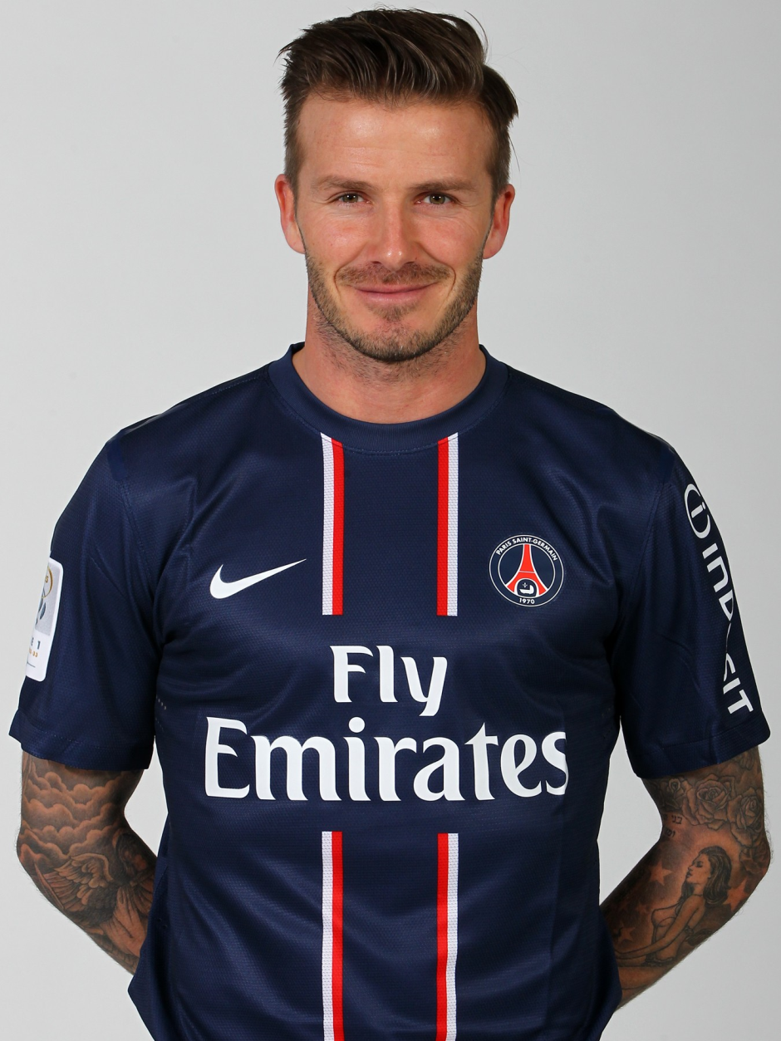
Person 1
David Beckham
His club manager said of him “he practised with a discipline to achieve an accuracy that other players wouldn't care about.” and he was a fantastic footballer “…not because of God-given talent but because he practises with a relentless application that the vast majority of less gifted players wouldn’t contemplate”
He suffers from obsessive compulsive disorder (OCD)
Was the world’s highest earning footballer at age 37
Donated all of his wages to a children’s charity in his last 5 months playing football.
Most capped England outfield player of all time

Slide 18
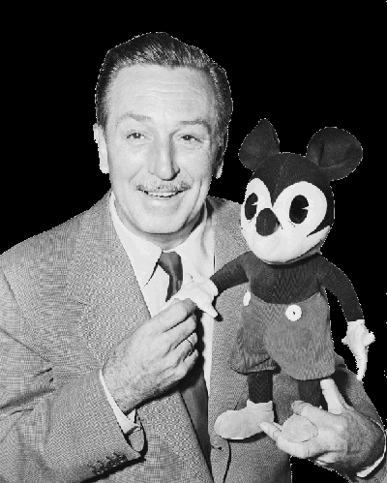
Person 2
Walt Disney
Fired from his job at a newspaper because "he lacked
imagination and had no good ideas”
His first animation company failed and it took him 307 applications for a loan to build his theme park.
He was told that the ‘Three little pigs’ needed more characters
It took him 16 years to get permission to film Mary Poppins
He was told that Mickey Mouse would terrify people

Slide 19
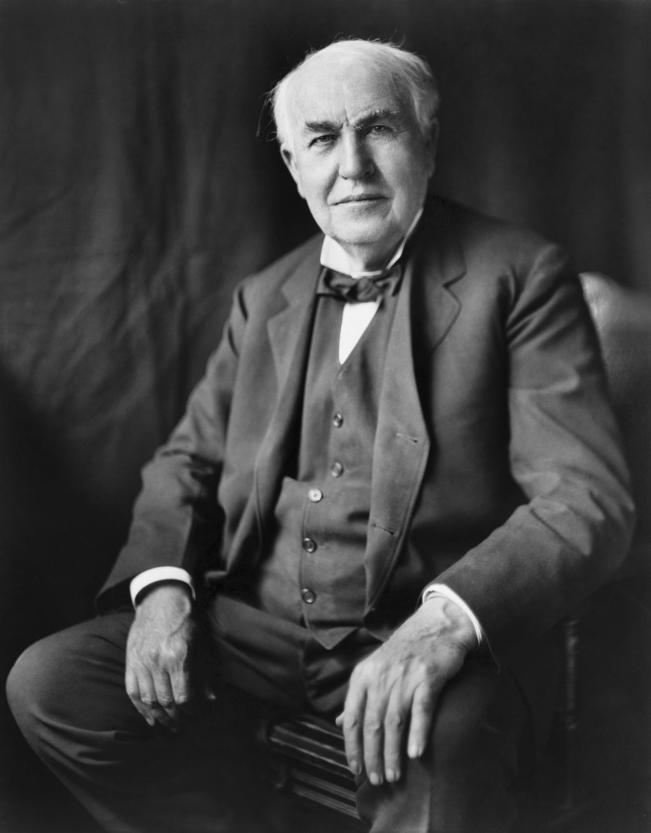
Person 3
Thomas Edison
He was told he was ‘stupid’ and ‘unteachable’ at school
He was fired from many jobs
He had many technical difficulties and money worries
Said “Genius is 1% inspiration and 99% perspiration”
He obtained 1093 patents – including the light bulb, battery
and record player (this is how we played music before CDs!)

Slide 20
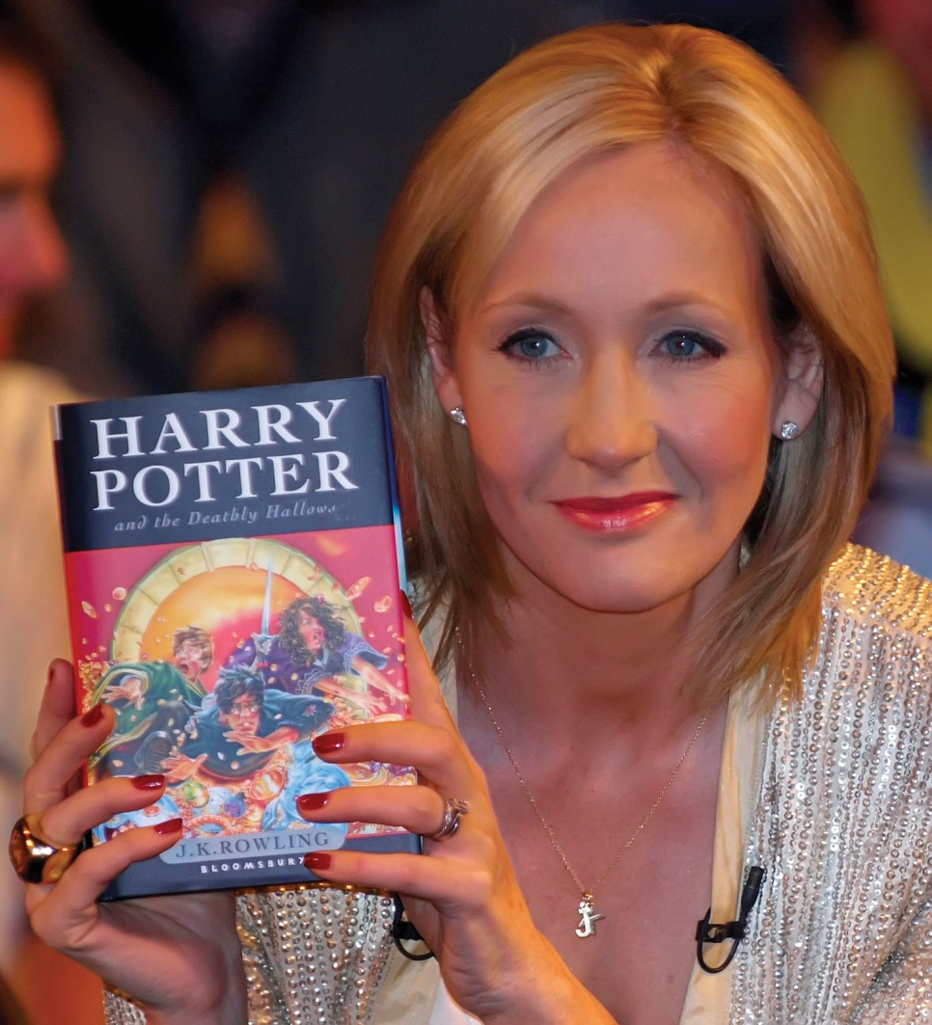
Person 4
J.K. Rowling
Was a single mother claiming unemployment benefit
Was so low she considered suicide
Wrote children's story’s while her baby slept
Received a grant to publish one of her stories
Became one of the most successful children’s authors of all time and one of the richest woman in the UK

Slide 21
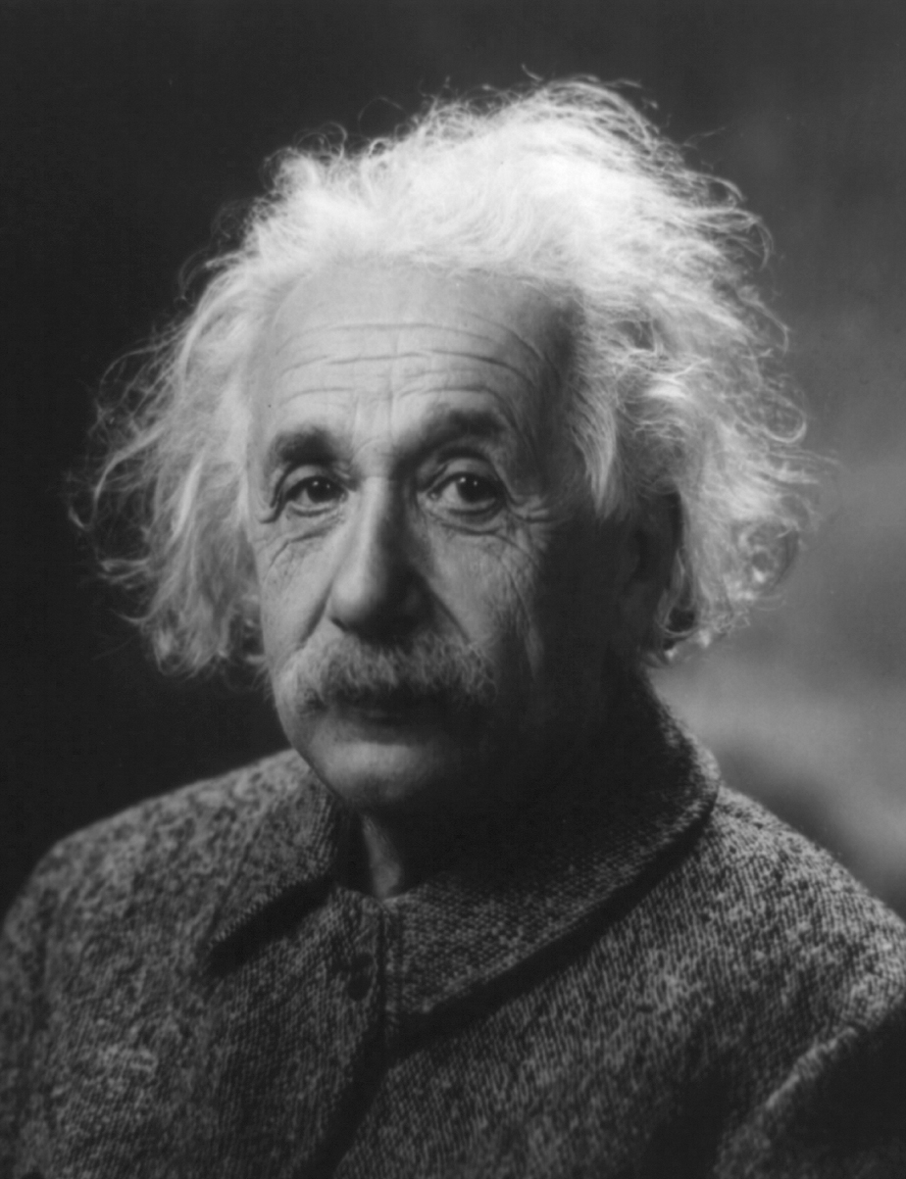
Person 5
Albert Einstein
Didn’t speak until he was three years old
Failed to impress his teachers all the way through college
His teachers thought he was lazy, sloppy, insubordinate, and that he would never amount to anything
Became a recognised ‘genius’ and fantastic scientist
E=MC²

Slide 22
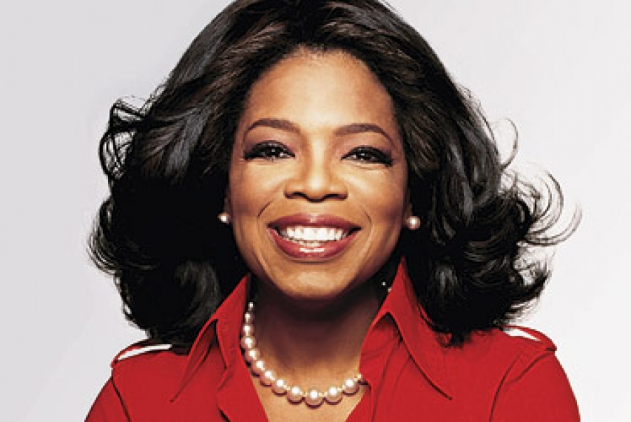
Person 6
Oprah Winfrey
Was born into poverty in rural Mississippi to a teenage single mother
Suffered considerable hardship during her childhood
She was raped at age nine and became pregnant at 14; her son died in infancy
She is now an American media proprietor, talk show host, actress, producer, and philanthropist.
She is worth around $3 billion, the richest African-American of the 20th century and America’s only black billionaire.

Slide 23
https://www.youtube.com/watch?v=zLYECIjmnQs

Slide 24
Plenary
Discuss:
What can we learn from these individual’s stories?
Basically… Hard work, practice, perseverance and effort – having a GROWTH MINDSET, can lead to success!
Don’t Give Up! http://www.youtube.com/watch?v=kZlXWp6vFdE

Slide 25
Next Week…
Failing your way to success

Slide 26
http://www.bbc.co.uk/scotland/brainsmart/.

